Slide 2

Cyber-physical Test Benches Remotely Controlled via Internet
Workshop as part of the MYiTOPS project.

Slide 3
Workshop Outline
First day: Presentation and Group Work
Morning [First Block]:
State of Technology
Definition of Digitization
Cyber-physical Systems
Embedded Systems
Fail-safe Communication and Cyber Security
Group Work + Discussion about results
Afternoon [Second Block]:
Technical Environment and Cooperation
Current Projects
Test Benches at HsKA / at UMP
Sensors, Actuators and Interfaces
Network / Internet
Open-Source and GitHub
Group Work + Discussion about results
Second day: Practical Introduction
Morning [Third block]: Introduction Github - Hello World
Set up Cyber-physical System with RPI
Set up Network and Server with Labview
Brainstorming and Requirement Analysis
06.11.17
| 3

Slide 4




Definition of Digitization
… is the process of converting information into a digital (i.e. computer-readable) format, in which the information is organized into bits… The result is called digital representation or, more specifically, a digital image, for the real object…
Digital transformation
Information of the Cat…
“Real World”
Object
“Digital World”
Object
Converting…
Neugebauer, Reimund. (2018). Digitalisierung: Schlüsseltechnologien für Wirtschaft und Gesellschaft. 10.1007/978-3-662-55890-4 Wikipedia - Digitization
Notes:
The Digit-Cat can used to understand Cats, the e-book can used to read the content!
Computer language- bits and bytes

Slide 5
Examples of established digital services:
Email (Letters)
E-Commerce (Trade)
Navigation Systems (Guides)
Streaming (Live shows)
Language Assistants (Translators)

Slide 6
What is particularly important in Digitization?
Form of the data (bits and bytes)
Data exchange via a (fast and efficient) Internet or local Network
Computers and servers are required to process the data
Input and output medium (smartphones, intelligent refrigerators, autonomous cars, smart robots ...)

Slide 7
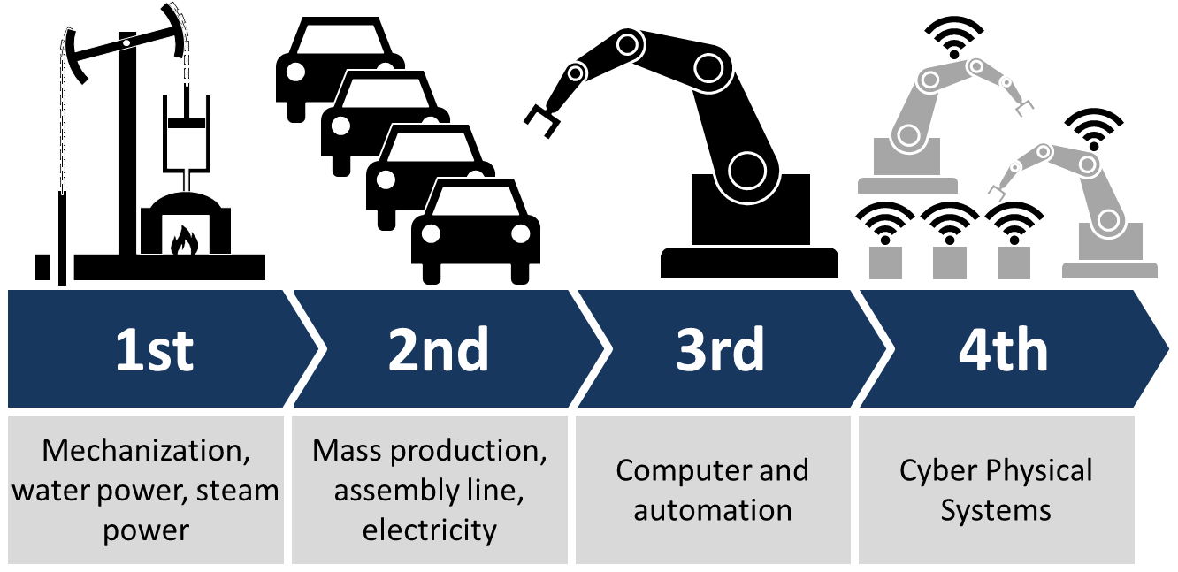
Digitization is bringing with it so many major changes that it is seen as the new industrial revolution.
Industry 4.0
Industrial revolutions and future view (Industry 4.0 - Wikipedia)
Notes:
Industry 4.0 is commonly referred to as the fourth industrial revolution.

Slide 8
These revolutions and evolutions include:
IoT (Internet of Things)
Cloud Computing
Big Data
Smart Home
Connected Car
Predictive Maintenance
Smart Energy
Smart City
3D-Printer
AI (Artificial Intelligence)
Blockchain
Crypto Currencies
Fintech (Financial Technology)
Virtual Reality

Slide 9
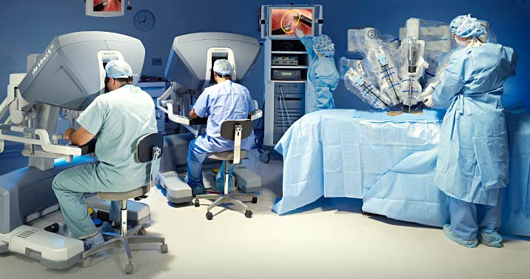
Applications
Remote surgery

Slide 10
Cyber-physical Systems (CPS)
"... linking of real (physical) objects and processes with information processing (virtual) objects and processes via open, partly global and always interconnected information networks"
VDI (Association of German Engineers)
A further development of the mechatronics to a symbiotic system approach on the basis of information technology.

Slide 11
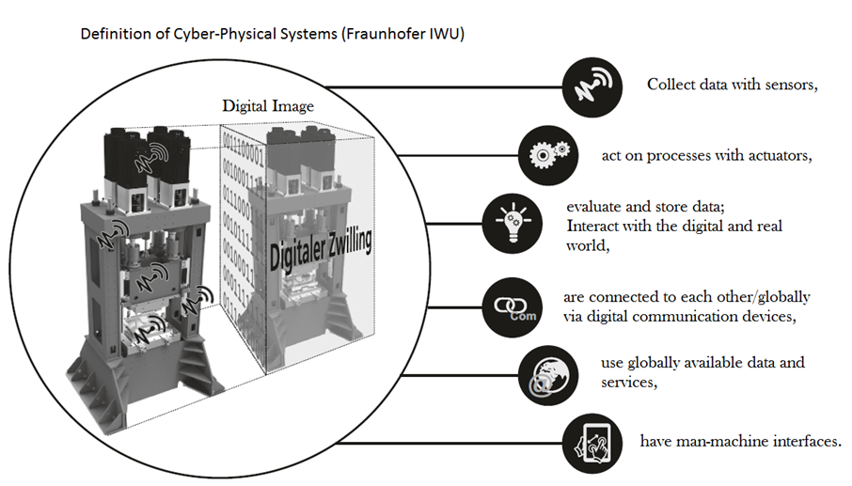
Neugebauer, Reimund. (2018). Digitalisierung: Schlüsseltechnologien für Wirtschaft und Gesellschaft. 10.1007/978-3-662-55890-4

Slide 12

What is meant by IoT? Relationship between IoT and CPS?
IoTs are not CPSs, but you can build them with CPSs.
The internet of things is a computing concept that describes the idea of everyday physical objects being connected to the internet and being able to identify themselves to other devices.
What is Internet without Things?
Notes:
Which goal is to be reach by networking and communicating the individual systems depends on the requirements of the overall system.

Slide 13
What is particularly important in cyber-physical systems (CPS)?
A cyber-physical system represents the desired unity of reality and digital image.
Sensory, actuatorial and cognitive functions can be integrated into technical systems.
Networkability of all components

Slide 14
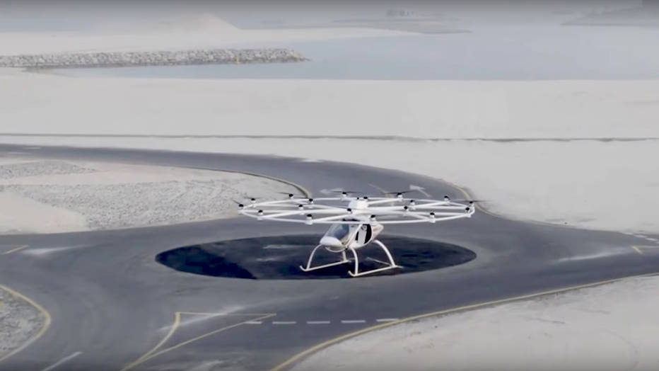
Fascinating perspectives of technical systems [3] Functionalities that have so far only been fulfilled by biological systems:
Autonomous Systems: These systems independently solve complex tasks within of a particular application domain.
Volocopter, an automonous flying taxi
Notes:
Add examples for each feature

Slide 15

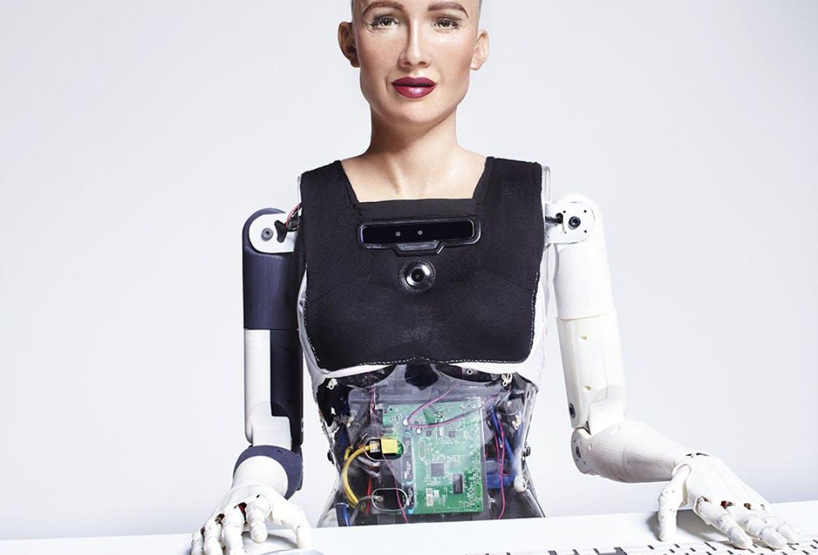
. . . Cont’d
Dynamically Networked Systems (System-of-Systems): The degree of system networking will increase. This will result in new, more complex systems, their functionality and performance exceeds the sum of the individual systems.

Slide 16
. . . Cont’d
Interactive Sociotechnical Systems: Opens up new perspectives on the interaction between human beings and the Machine. The systems will flexibly adapt to the needs of the user. [Google assistant]
Product-service Systems : Enables the fusion of material and process services for customer-oriented problem solutions.

Slide 17
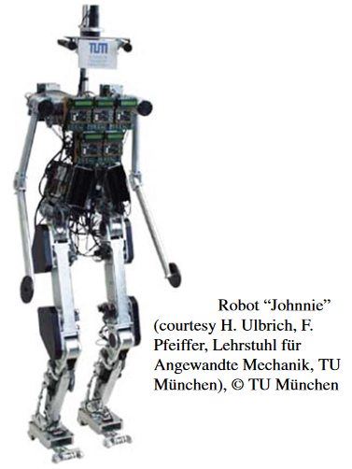
What is the technical basis of the CPSs?
Embedded Systems Design, Peter Marwedel, ISBN 978-3-319-56043-4
Cyber Physical Systems
Physical system
Embedded Systems
Relationship between embedded systems and CPS[4]
Robotics is also a traditional area in which embedded/cyber-physical
systems have been used. Mechanical aspects are very important for robots. Robots, modeled after animals or human beings, have been designed.

Slide 18
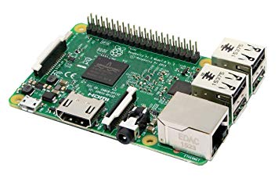
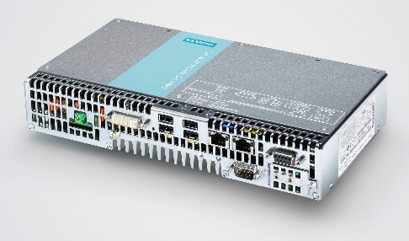
Definition of Embedded Systems (ES)
IEEE has the following definition for embedded systems: An Embedded Computer System: A computer system that is part of a larger system and performs some of the requirements of that system; for example, a computer system used in an aircraft or rapid transit system.
(Institute of Electrical and Electronics Engineers, 1992)
Raspberry Pi 3
Simatic Microbox PC 427B von Siemens

Slide 19
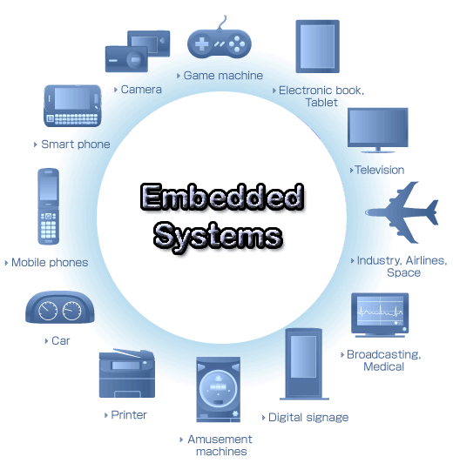
Examples of Applications of ESs:
Automotive Technology :
ABS (Anti-Lock Braking System)
Adaptive Bend Lighting
ESP (Electronic Stability Program)
Electronic Injection System
Navigation System
Infotainment
Cruise Control
Drive by Wire
Medicine Technology:
Surveillance Systems
(Monitoring)
Electronic gas dosing
Glucose Testers
Infusion Pumps
Respirators
Incubators
EEG Systems
ECG System
Automation Technology:
Process control
robotics
Sensor/Actuator Interface
Bluetooth
Buses: Profibus, DeviceNet CANopen, Interbus
e-wire systems
Consumer Goods:
CCD Cameras
Smartphones
MP3 Player
Smarthome Devices
TVs
CD/DVD Systems
Washing Machines
Aircraft Technology:
Autopilot
Artificial Horizon
Tail Stabilizer Bars
Wing Dynamics
Infotainment
Engine Control
Mechatronic Monitoring
Image: https://www.quora.com/What-is-an-embedded-system

Slide 20
Main Features of Embedded Computer Systems
Dedicated Function within a larger mechanical or electrical system.
Response Behavior: Realtime, Hard Realtime, i.e. reaction time to requirements/changes.
-Hard Realtime: missing a deadline is a total system failure.
-Firm Realtime: infrequent deadline misses tolerable, but may degrade the system's quality of service. The usefulness of a (single) result is zero after its deadline.
-Soft Realtime: usefulness of a result degrades after its deadline, thereby degrading the system's quality of service.
Fixed Restrictions: size, performance, power, costs.
What is Realtime? Time between events? Sampling rate?
Response Time in IoT: Imagine you do a phone call where your words will need 2 sec to arrive…

Slide 21
Internet and Cyber Security
Cyber security is the basis for successful digitization to protect systems such as
digital production (industry 4.0)
smart energy supply
logistics and mobility
health care
public administration
cloud-based services
Blackout: Marc Elsberg at TEDxBerlin
https://www.youtube.com/watch?time_continue=926&v=YuM5iCn_iKI

Slide 22
The most important protection goals:
CIA
CONFIDENTIALITY
- rules limited access to information
INTEGRITY
- assures the information is trustworthy and accurate
AVAILABILITY
- a guarantee of reliable access to the information by authorized people
Digitization and networking and the associated link between the digital and physical worlds make it difficult and complex to reach these goals.
In order to avoid economic and social damage, these points must be guaranteed and must be considered depending on the applications.

Slide 23
Failsafe und security technical systems. How?
Absolutely closed and self-controlling system?
It is not possible!
Example Connected Car:
Attacks via media interfaces (Bluetooth, USB, WLAN-Hotspots)
Influencing vehicle sensors and Car2X communication
Attacks and changes in physical access to the vehicle
Attacks on backend systems via web (e.g. Smartphone Vehicle Apps)
Faults due to wear and tear (including control mechanisms)
https://www.it-daily.net/it-sicherheit/cyber-defence/18736-die-groessten-gefahren-fuer-die-it-sicherheit-im-connected-car

Slide 24
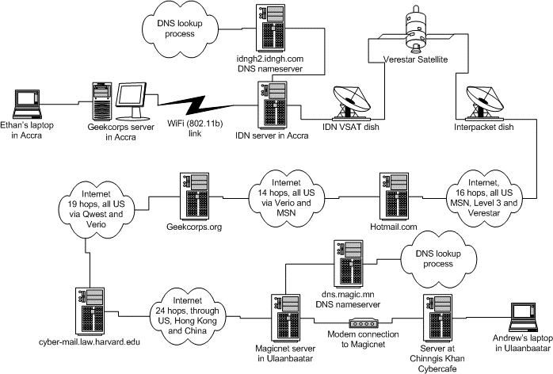
The Internet is a public space! Don't forget. What does this mean for a fail-safe and secure connection over the Internet?
Too many "computers" involved who can cut off or manipulate the data exchange!
"Around the World in 900 Milliseconds"
Here's the itinerary for Andrew's intrepid packets -- the path from his laptop to his Harvard mailserver:
1 cobalt03.mn (Magicnet Mongolia) (202.131.0.79) 2 China Satnet (203.222.194.18) 3 China Satnet (203.222.192.97) 4 SATNETEX - China Digital satNet Ltd. (203.222.192.68) 5 DigitalNetworkAlliance.GW.opentransit.net (193.251.252.230) 6 P2-1-0.HKGAR1.Hong-kong.opentransit.net (193.251.241.198) 7 P2-3.HKGBB2.Hong-kong.opentransit.net (193.251.242.189) 8 P13-0.SJOCR2.San-jose.opentransit.net (193.251.242.90) 9 P4-0.SJOCR1.San-jose.opentransit.net (193.251.242.2) 10 P5-0.NYKCR2.New-york.opentransit.net (193.251.251.225) 11 P4-0.NYKCR3.New-york.opentransit.net (193.251.242.253) 12 So2-0-0.ASHBB1.Ashburn.opentransit.net (193.251.248.177) 13 dcp-brdr-01.inet.qwest.net (205.171.209.46) 14 dca-core-01.inet.qwest.net (205.171.9.9) 15 dca-core-03.inet.qwest.net (205.171.8.218) 16 jfk-core-03.inet.qwest.net (205.171.230.6) 17 jfk-core-01.inet.qwest.net (205.171.8.19) 18 bos-core-02.inet.qwest.net (205.171.28.29) 19 bos-edge-02.inet.qwest.net (63.145.1.133) 20 Harvard router (192.5.66.5) 21 border-gw-ge-wan3-1.fas.harvard.edu (140.247.2.5) 22 core-1-gw-vl415.fas.harvard.edu (140.247.2.61) 23 core-nw-gw-vl216.fas.harvard.edu (140.247.216.1) 24 cyber-mail.law.harvard.edu (140.247.216.113)
https://cyber.harvard.edu/digitaldemocracy/internetarchitecture.html

Slide 25
How can we establish a fail-safe communication and secure connection?
Using cryptographic network protocols: SSH, HTTPS, etc.
Data integrity: Checking the correctness of the data and data structure
Develop autonomous systems related to connection breakdowns
These three points must stay in your head!

Slide 26
Division into three working groups for each question: processing time 15 min and presentation of the results 10 min for each group.
Group 1:
What is meant by new industrial revolution?
Group 2:
How can technical systems be digitized?
Group 3:
What is the difference between a stable and secure connection?
[15mins of discussion, 10mins of presentation]
Notes:
Tafel -> saving time, location-independent cooperation, project management, Monitoring development, Coordination of tasks, Scientific added value

Slide 27
Lunch Break! See you soon…

Slide 28



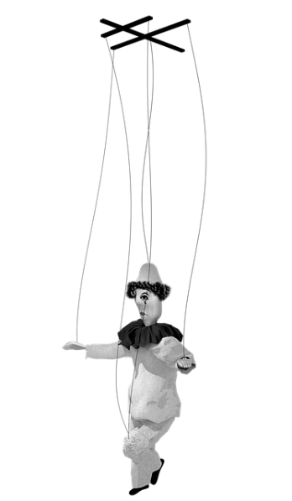
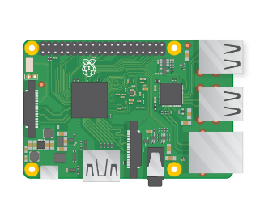
Cyber-physical Test Benches Remotely Controlled via Internet
Transfer digital data …
Server
Remote Control
Peer-to-Peer (P2P)
and encrypted…
Converting to digital object…
Data acquisition and Controlling via a cyber-physical
system

Slide 29
Technical Environment and Cooperation
[Outline]
Current Projects and Test Benches in Karlsruhe
Sensors, Actuators and Interfaces
Network / Internet
Open-Source and GitHub
Group Work + Discussion about results

Slide 30
Current IoT Projects (HS)
EtaNet CPS-Energy System
Integration of Combined Heat and Power Plant (CHP) in EtaNet
Integration of EV Charging Station at HsKA-Campus Bruchsal in EtaNet
Power Tools Test Bed in Altitude and Environmental Chamber at HsKA-Campus in Bruchsal
Remote Control for Power Tools Operation e.g. Chain Saw

Slide 31
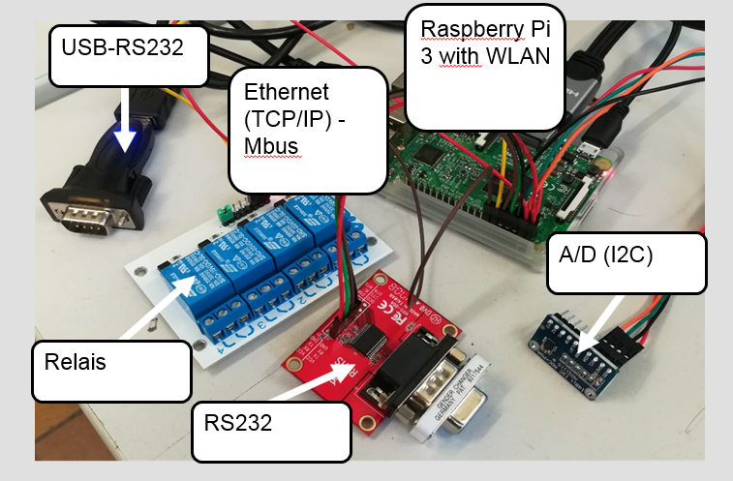

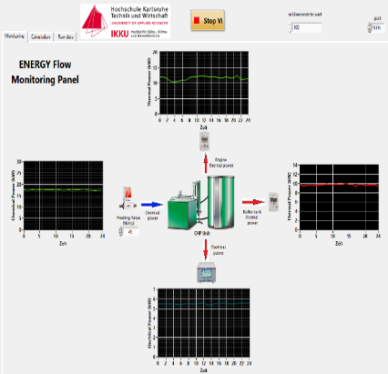
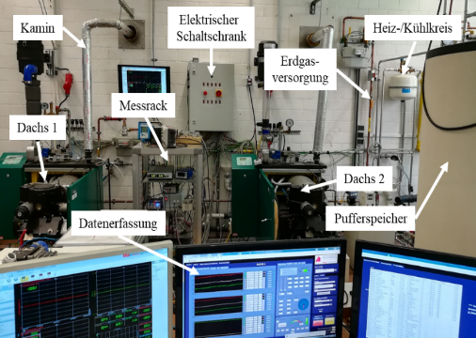
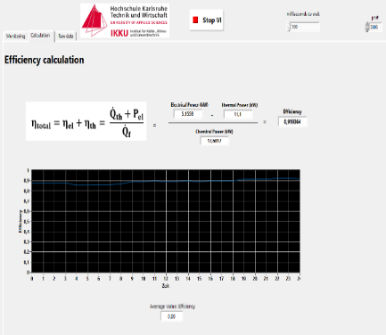
Combined Heat & Power (CHP)
CHP Efficiency Analysis
Mitchell Enrique Kuansin, Ferhat Aslan
https://github.com/IKKUengine/CHPefficiency (Python and LabVIEW)
06.11.17
| 13

Slide 32
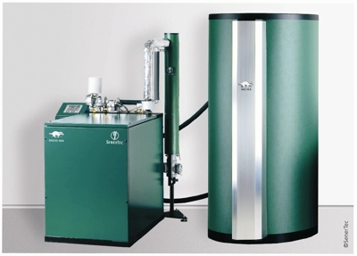
Guidelines for “CHP Efficiency” Project
Ready
Raspberry PI controlled hardware
Gas Flow Meter
Heat Meters
Power Analyzer
Data backup with SQLite database
Data processing via the Labview server
In Process
Remote control over the Internet.
CHP POWER PLANT

Slide 33
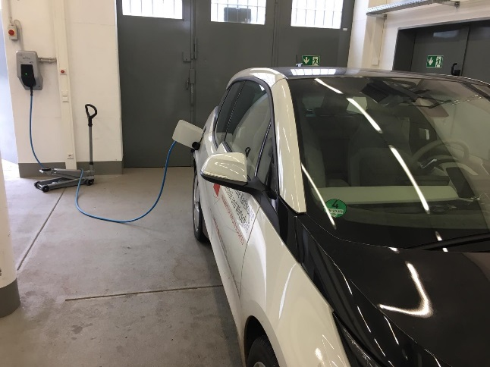
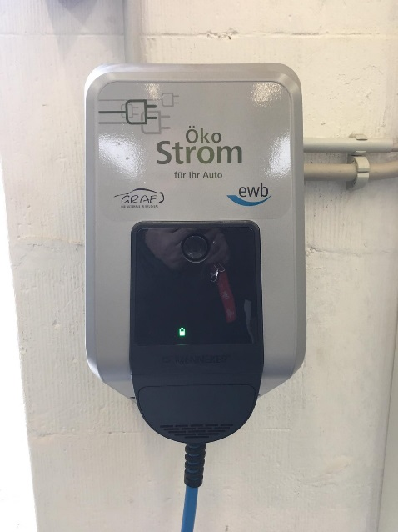
CPS Electric Vehicle Charging Station
In Process
Management concept for CHP and charging station
Laboratory setup
Remote control over the Internet
➔ CHP Power Plant operation strategy will interact with charging system to reduce CO₂ and energy cost
CHP POWER PLANT
Pavel Smirnov, Ferhat Aslan
06.11.17
| 13

Slide 34
Guidelines for “CPS-Energy System
Ready:
Standardization of communication and control
Interface for a management algorithm
Interface for a data monitoring
Object-oriented observation and programming / parameterization
Data backup with SQLite database
Published as Open-Source
In Process:
Access to the entire system via a secure server-side database
First working management algorithm: Combination electric vehicle charging station with combined heat and power unit

Slide 35
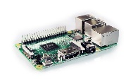
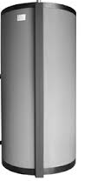
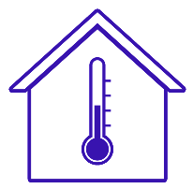

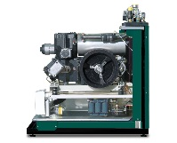
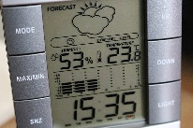
A higher goal is the networking of all cyber physical objects, which allows a collective management.
Scalable Higher-Level System
First results from the ηNet project: https://github.com/IKKUengine/SimulatedCPSLabVIEWEnergySystem (LabVIEW, Open Source License MIT)

Slide 36
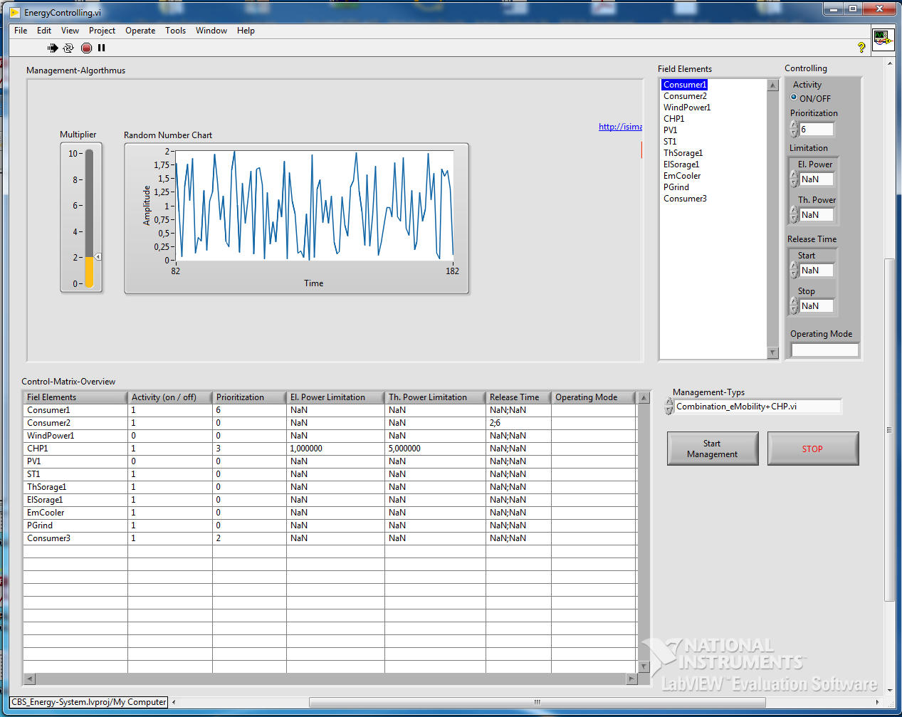
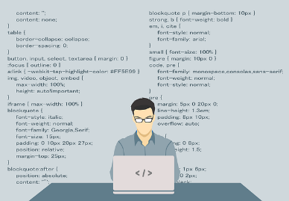
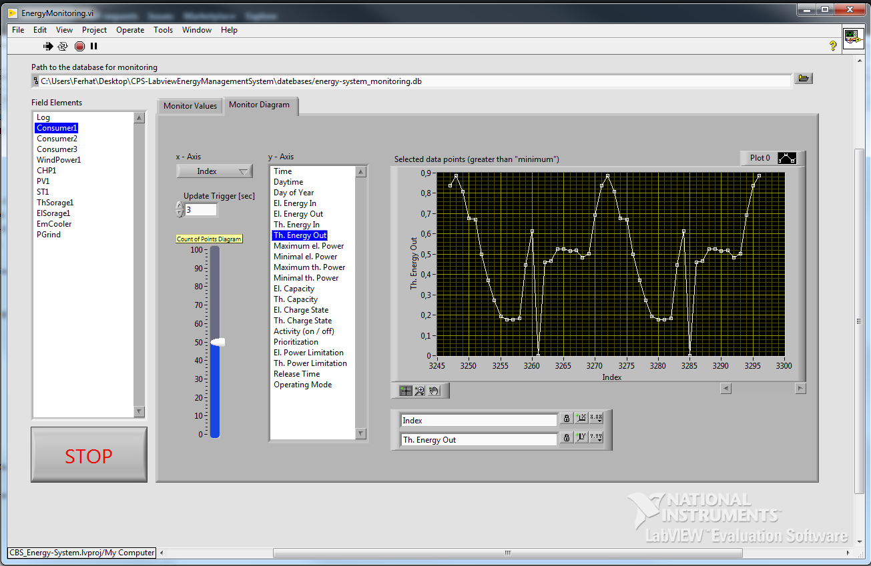
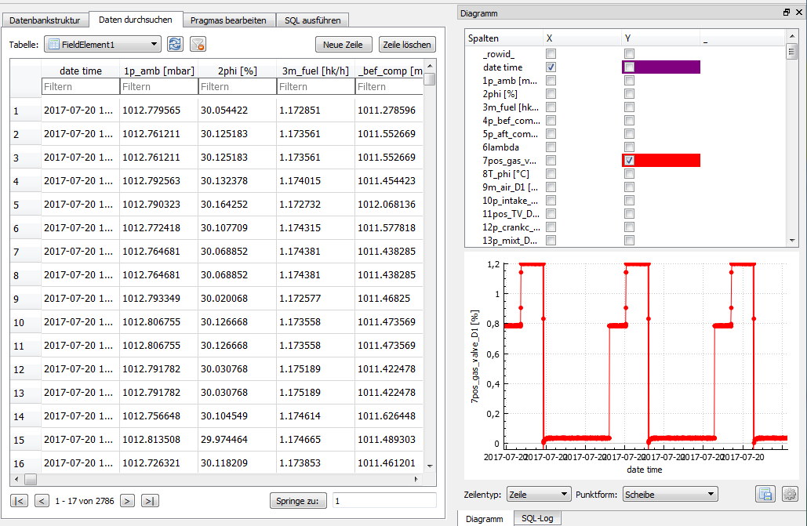


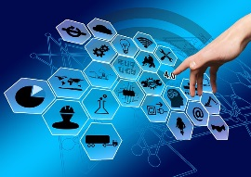

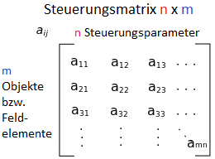
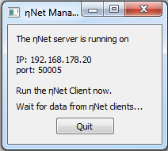
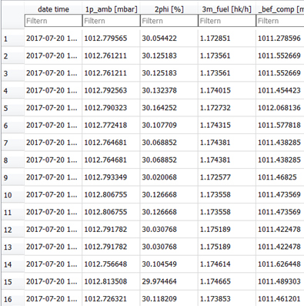


OPP-oriented Programming Paradigm
Management Interface
Monitoring
Handler
Data Collector
Cyber-Physical Objects
Producer
Consumer
Storage

Slide 37
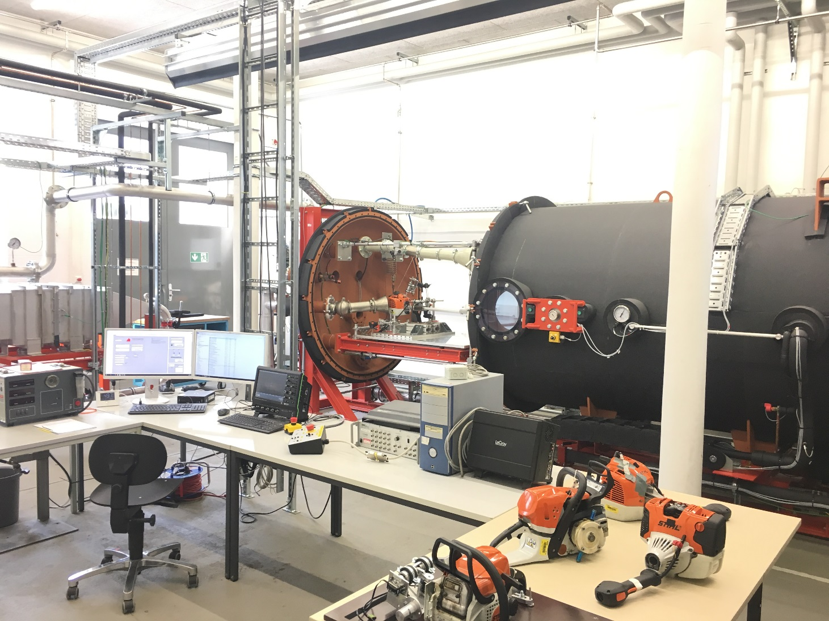
Environmental Chamber Bruchsal
Artur Martel, Arsema Derbie, Dennis Weierter

Slide 38

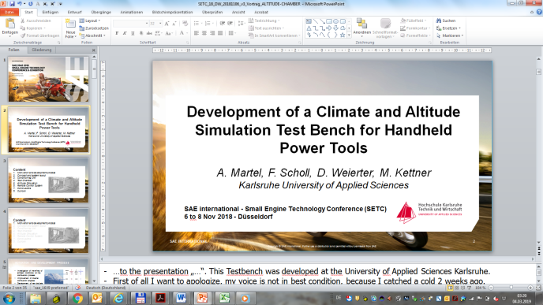
Environmental Chamber (HsKA Campus Bruchsal)
Target:
Operating the power tool on the test bed from any place in the world.
e.g. Industrial partners can rent the test bed and operate their products via the internet with out traveling to HsKA ➔ less travel time, less travel cost
R&D: e.g. Cold Start Tests: long waiting time after cold start and warm up before you can do the next test! With IoT-control the operator don‘t need to „wait“ in the lab. Even he/she is on a business trip, in a meeting, doing Office Work while conducting the tests (remotely!)
Bla-bla-bla … boring meeting!
It‘s time for the next test on my testbed
www.humanresourcesonline.net

Slide 39
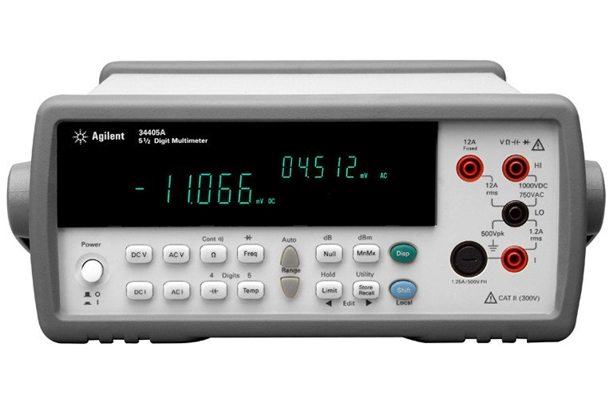
Guidelines for “Environmental Chamber” Project
Ready:
LabVIEW controlled Software (Server)
Data backup with SQLite database
Agilent Digital Multimeter
In Process:
Raspberry PI (clients) for controlling, data acquisition and networking:
Throttle regulation
Temperature regulation
Etc.

Slide 40
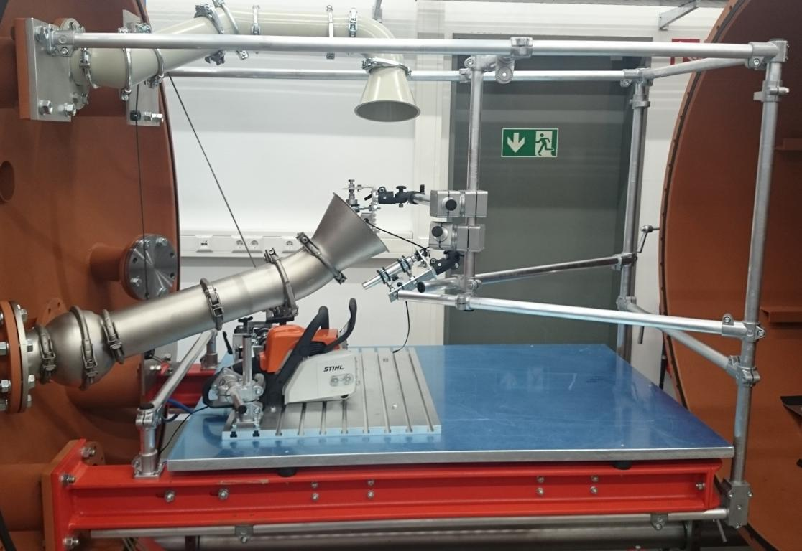
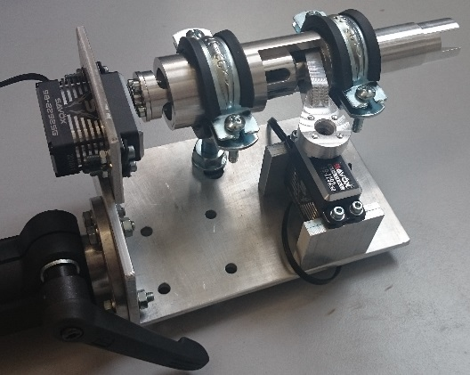
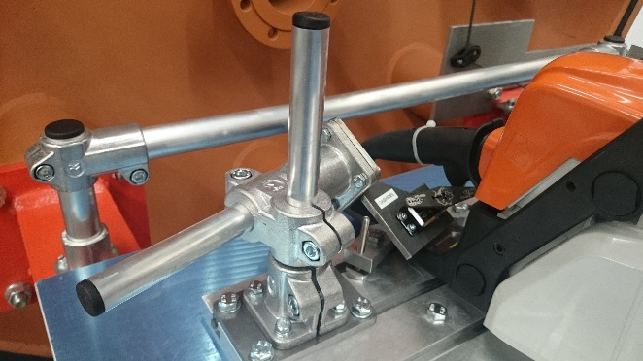
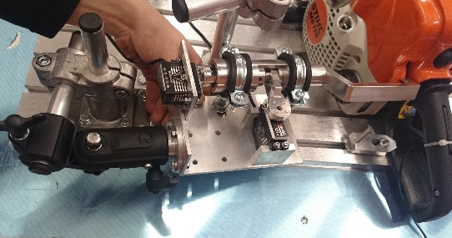
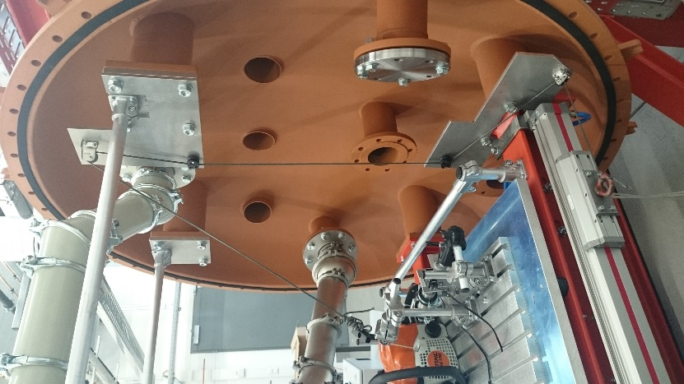
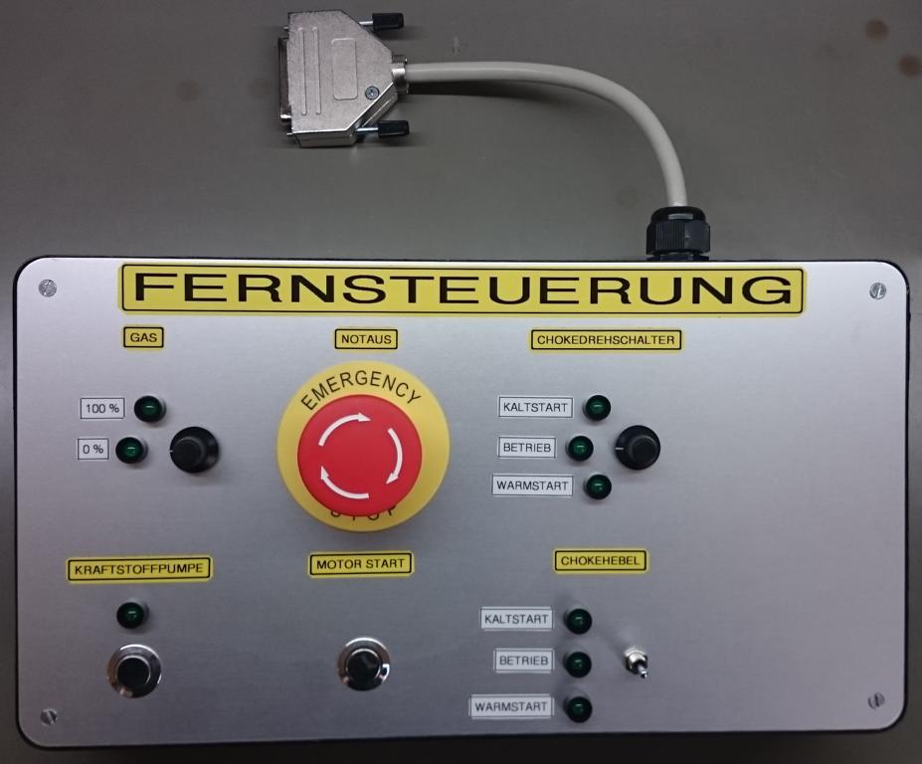
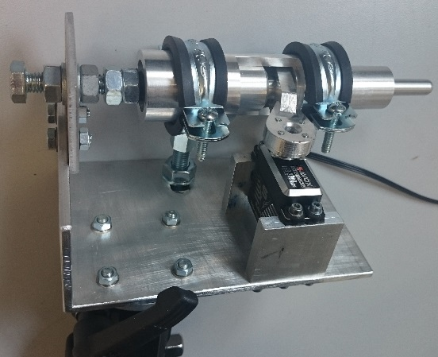
Remote Control for Power Tools e.g. Chain Saw
turn & push
push
Cable!? Tststss…this is so retro!
turn
pull
push
Dennis Weierter

Slide 41
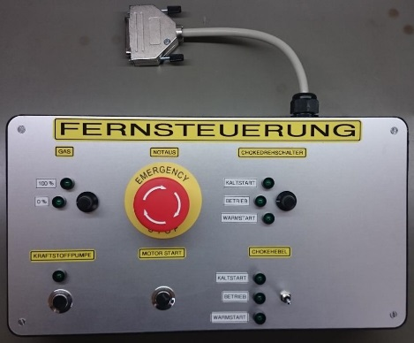
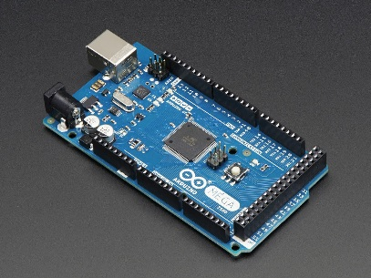
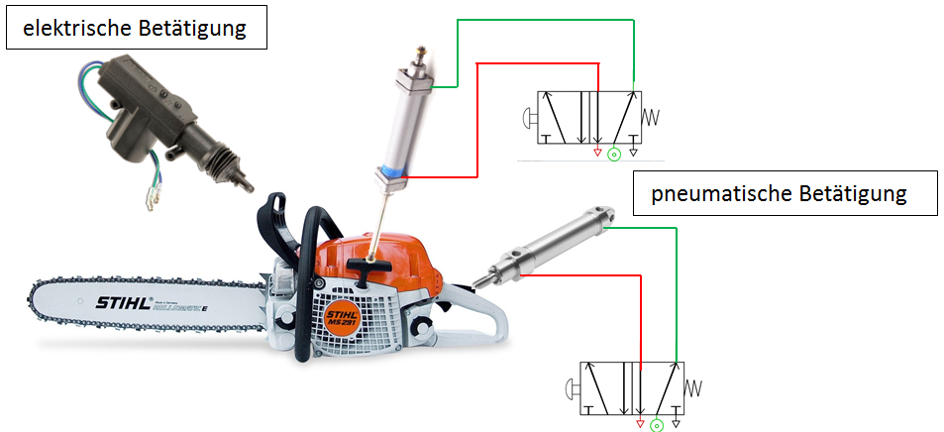
Guidelines for “Remote Control Chain Saw” Project
Ready:
Arduino controlled hardware
Servomotors as actuators
Pneumatic cylinder for rope start
With hardware operating unit
In Process:
Raspberry PI (clients) for controlling, data acquisition and remote control over the Internet.

Slide 42
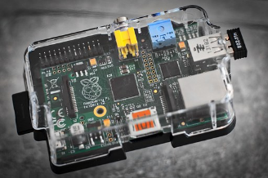
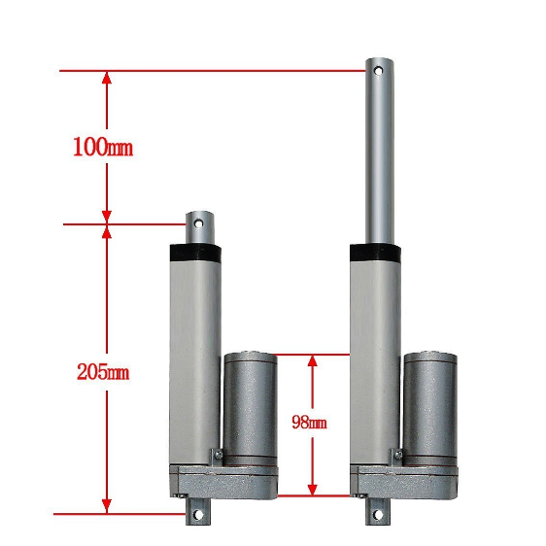
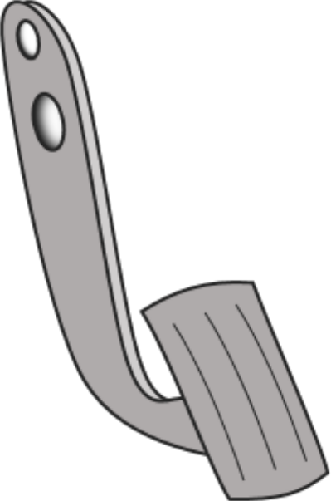

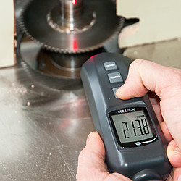
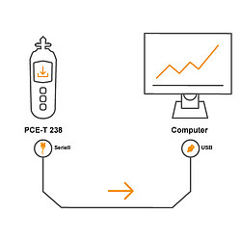
Remote Controlled Accelerator Pedal
In Process:
Driving Speed Profile
Laboratory setup
Remote control over the Internet
ECO-WORTHY Linear Actuator
Project Group - UMP
www.pce-instruments.com

Slide 43







Remote Controlled Accelerator Pedal
www.gestion.pe
Vehicle Speed in km/h
Time in s

Slide 44
Sensors, Actuators and Interfaces
How do we get physics into the digital world?

Slide 45

Overview image board computer car:
http://akautomotiveservices.co.uk/training-courses-vehicle-electrics-module-3/

Slide 46

How do I get physical or chemical quantities on my computer?
https://www.researchgate.net/figure/Base-physical-quantity-name_tbl1_283195320

Slide 47




Sensorsystem
Sensors
Physical or Chemical Quantity
Example: Light Sensor
Light
Conversion to a digital electrical signal: ON/OFF.

Slide 48

Actuator system
Actuators
Physical or Chemical Quantity
Light
Example: Light Actuator
Conversions to an analogue electrical signal: switch on!
Sending digital electrical signal
Switch-on System

Slide 49

The computer understands only (digital) 0 or 1!
https://www.slideshare.net/AsifIqbal109/digital-to-analog-dac-analog-to-digital-converter-adc

Slide 50
Sensors and actuators have different interfaces for signal transmission with the computer.
Some of the most common interfaces and protocols are:
RS232
USB
I2C
Ethernet
CAN
Digit I/O
Analog I/O
Etc.

Slide 51


Back to our cat:
Information of the Cat…
“Real World”
Object
converting over the interfaces
Cat-data to be sent…

Slide 52

Send the Cat-data to Germany now!
It's very complex!?

Slide 53


Internet? Any computer can connect to any other computer.
There are two connection types:
Peer-to-peer (P2P) network
Network based on the client-server model
Peers are equally privileged, equipotent participants in the application.
Individual clients request services and resources from centralized servers.
https://en.wikipedia.org/wiki/Peer-to-peer

Slide 54

How do computers interact?
A set of commands exists to control communication between two devices, e.g. between two computers.

Slide 55

Internet Protocol
The rules or set of commands are grouped together in the Internet Protocol family.
Is it very complex!? Yes and no…
https://en.wikipedia.org/wiki/Internet_Protocol

Slide 56

“Imagine, TCP is the data. IP is the Internet location GPS.”
It's easier to think in layer:
The Link Layer is the physical network equipment used to interconnect nodes and servers.
The Internet Layer connects hosts to one another across networks.
The Transport Layer resolves all host-to-host communication.
The Application Layer is utilized to ensure communication between applications on a network.
https://www.hostingadvice.com/blog/tcpip-make-internet-work/

Slide 57


For us, it is only important to use the tools that can go by these rules.
LabVIEW makes it easy, just learn it.
A simple higher layer (like building blocks) makes the development uncomplicated.
Internet
„Malaysia“
„Germany“
https://stackoverflow.com/questions/30994389/labview-programming

Slide 58


Python makes it easy, just learn it.
The same as LabVIEW only with text code…
Server-Code
Client-Code
Internet
„Malaysia“
„Germany“
https://www.bogotobogo.com/python/python_network_programming_server_client.php

Slide 59
More in the third block: Practical Introduction

Slide 60

How can we work together between Germany and Malaysia?
How do we stay in touch?
How do we divide the work between us? Workflow?
How can everyone always be very well informed about the status of projects and members?

Slide 61




Solution…

Slide 62
What is GitHub?
It lets you and others work together on projects from anywhere.
GitHub is a website and cloud-based service:
Store,
manage,
track and
control changes of your project documents.
To understand exactly what GitHub is, you need to know two connected principles:
Version control
Git
https://kinsta.com/knowledgebase/what-is-github/

Slide 63

What Is Version Control?
Also known as revision control or source control, is the management of changes to documents, computer programs, large web sites, and other collections of information (Wikipedia.org).
commit
init
Collaboration with repositories and handful of commands!
pull
branche
merge
push
https://en.wikipedia.org/wiki/Version_control

Slide 64

Repositories
Colloquially known as a "repo" for short.
Repo is a "directory or memory" with additional properties.
Alice, David, Bob and Clair can create a clone repo from the original to the local computer
They can continue the development locally. Time parallel!
In the meantime, if something changes in the origin (also among subteams). Then it can be fetched via "pull".
https://prewajdena.cf/wireless/351contrile-de-version-avec-tilichargement-github.html

Slide 65

Repo is a "directory or memory" with additional properties? You can do many things…
Let's cook with Git.
Init „RepoTable “
Commit „Create empty table“
Add to „RepoTable“ milk, eggs and soup
Your partner wants to help you
you order rice for the meal, but you don't want to be disturbed
Branch “RiceBranch” revision r4 to r5
Clone “RiceBranch”: Now the branch can be copied or cloned on local development machines
Add to “RiceBranch” rice (r6)
Commit „I cooked rice“
Merge it to (r7) „RepoTable“ (->r8)
Enjoy your meal…

Slide 66

With which tool can ofline work on the local computer to simply then update the Origin on the server?
https://git-scm.com/downloads
https://git-scm.com/docs/gittutorial
But we only learn the handling in the workshop via the platform. More in the third block: Practical Introduction…

Slide 67

An example: The creation of this presentation.

Slide 68
Division into three working groups for each question: processing time 15 min and presentation of the results 10 min for each group.
Group 1:
What is meant by analog and digital signals?
Group 2:
What is meant here by server and client and how can communication via the Internet be made easy?
Group 3:
What can we do together to establish an active
cooperation?

Slide 69
Brainstorming and Requirement Analysis for Remote Controlled Test Benches between HS and UMP (15 min)
1. Step
Brainstroming: With regard to the technical possibilities in HS and UMP - > Ideas for test benches / systems and their implementation
2. Step
Concrete requirement analysis for the system ideas: measured variables, measurement technology, controlling, time management
Moderator summarizes all ideas on the board.

Slide 70

Software Publications
https://github.com/IKKUengine/SimulatedCPSLabVIEWEnergySystem (LabVIEW)
https://github.com/IKKUengine/CHPefficiency (Python)
Will follow soon:
https://github.com/IKKUengine/SingleServerCHPefficiency (LabVIEW)
https://github.com/IKKUengine/ThreadedEtaNetServer (C++/Qt5.8)
https://github.com/IKKUengine/CPOEtaNetClient (C++/Qt5.8)
GitHub.com/ikkuengine

Slide 71
Dankeschön…
Contact
Ferhat Aslan
Institut für Kälte-, Klima- und Umwelttechnik
Tel.: 0721 925-1815
Raum M-U07
E-Mail: ferhat.aslan@hs-karlsruhe.de
Prof. Dr.-Ing. Maurice Kettner
Fakultät für Maschinenbau und Mechatronik
Tel.: 0721 925-1845
Raum F-111
E-Mail: maurice.kettner@hs-karlsruhe.de

